Slide 1

New Zealand ORCID Consortium 2024 Town Hall
19/06/2024
Dr Alex Freemantle – ORCID Lead, Royal Society Te Apārangi 0000-0002-0535-0662

Slide 2
ORCID – The Three Main Services
An ORCID Record – Can include employment, education, funding, professional activities, peer review, research outputs and other metadata
An ORCID iD – A unique, persistent identifier free of charge to researchers
A set of APIs – The service and support that enable interoperability between an
ORCID record and member organisations
Beneficial to researchers, institutions, employers, funders…

Slide 3
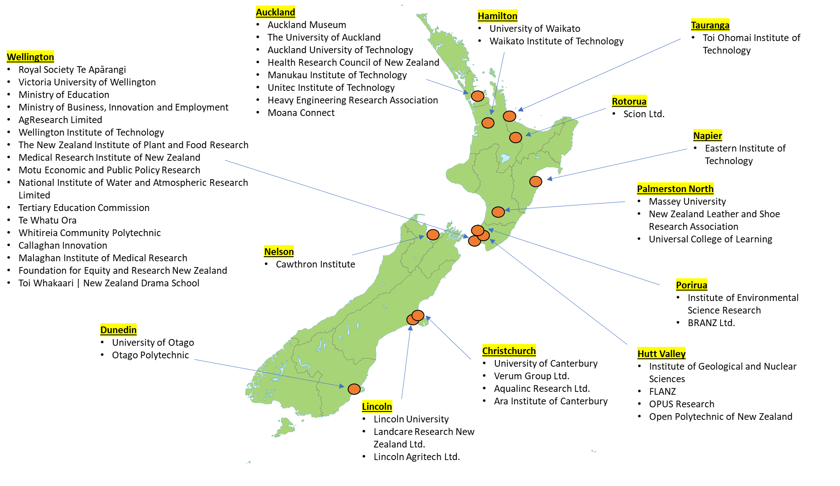
The New Zealand ORCID Consortium

Slide 4
Current ORCID Statistics in New Zealand
Statistic | Total
Users with New Zealand in biography | 11,112
Users with an affiliation based in New Zealand | 27,122
ORCID Records associated with a .nz email address | 32,556
* Correct as of June 2024

Slide 5
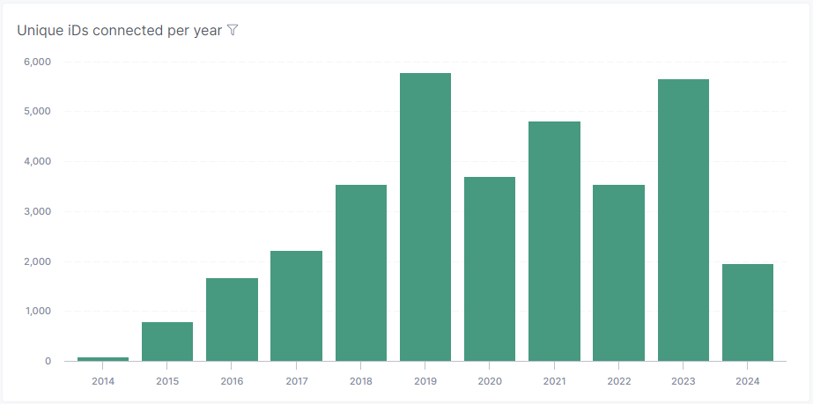
New Zealand ORCID Consortium 2024
49 Consortium Members
8th Largest Consortium Worldwide
34 Members with Integrations
28,667 Total Works added
4,187 Total Funding items added
Notes:
Te whatu ora merger

Slide 6
Achievements in 2023/24
Three new NZ ORCID Consortium Members
  Foundation of Equity and Research New Zealand (FERNZ)
  Moana Connect
  Toi Whakaari | New Zealand Drama School
Exciting new (and re-started) integrations
New members of the NZ ORCID Consortium Advisory Committee
Continued strong use of the NZ ORCID Hub

Slide 7
FLANZ – OJS ORCID Integration
Simon Atkinson (co-editor of the Journal of Open, Flexible and Distance Learning) at FLANZ has provide a video discussing their ORCID integrated OJS system.
https://www.youtube.com/watch?v=POL2HQ9Y2CY

Slide 8
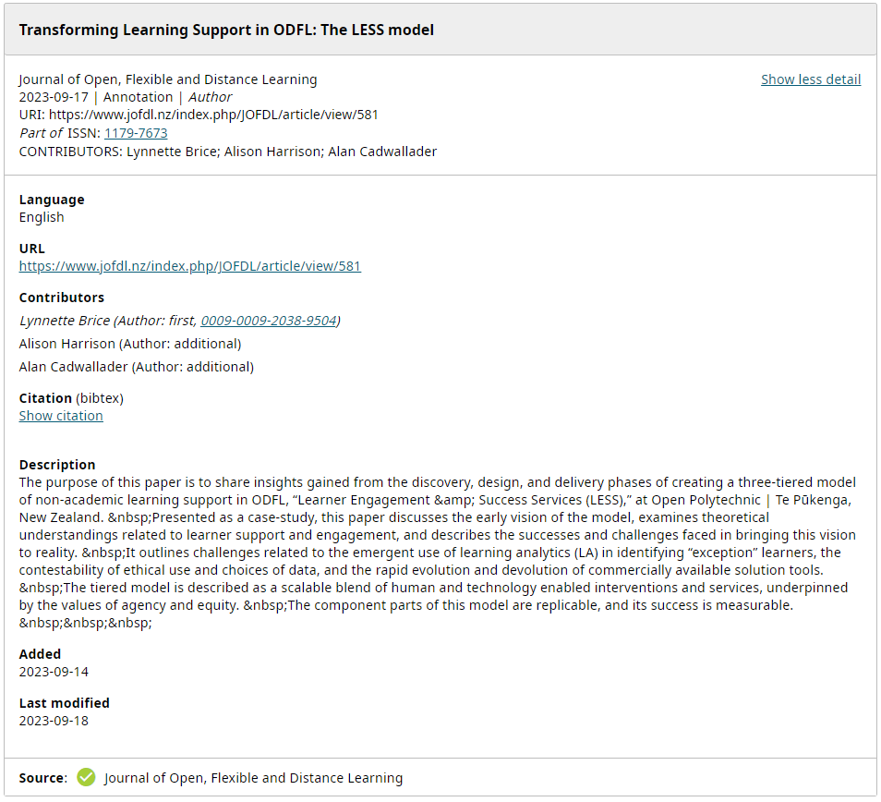
FLANZ – OJS ORCID Integration

Slide 9
Members Onboarded to the NZ ORCID Hub
Whitireia & Weltec
Auckland Museum
MBIE
Te Whatu Ora
Eastern Institute of Technology
GNS
BRANZ
Unitec Institute of Technology
Manaaki Whenua
Malaghan Institute of Medical Research
Otago Polytechnic
Lincoln Agritech
Scion
Motu Economic & Public Policy Research Trust
MRINZ
Lincoln University
AgResearch
Massey University
The University of Auckland
Royal Society Te Apārangi
Ara Institute of Technology
University of Otago
ESR
Plant and Food Research
Victoria University of Wellington
University of Canterbury
NIWA
Auckland University of Technology
Onboarded to the Test Hub
LASRA
The University of Waikato
Moana Connect
FERNZ
Notes:
Moana Connect and FERNZ at differing stages of test hub onboarding

Slide 10
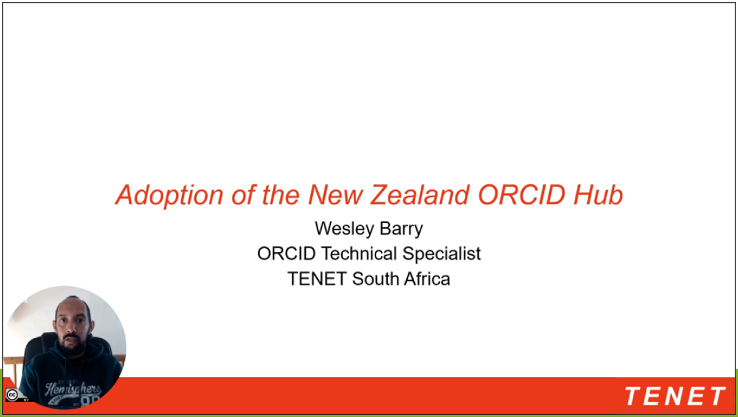
Presentation from South African Consortium:
The video can be found on our website.

Slide 11
New Zealand ORCID Work Programme Agreement
A new Work Programme Agreement between MBIE and Royal Society Te Apārangi has been signed and will commence on 1 July 2024
This Work Programme Agreement confirms Royal Society Te Apārangi will remain the Consortium Lead Organisation until June 2029
MBIE have pledged to continue to cover consortium members’ ORCID membership costs until June 2029
The ORCID Inc fee structure will change to a fee-per-organisation structure from October 2024

Slide 12
New Zealand ORCID Consortium Plans for 2024/25
Increase ORCID activity within the consortium, especially among non-active consortium members
Provide a wider range of webinars and events that can benefit consortium members
Increase the number of on-site visits to consortium member organisations
Continue to meet MBIE Work Programme expectations

Slide 13

ORCID Inc: 2023 Achievements and 2024 Plans
Watch the ORCID Inc Annual Community Town Hall on the ORCID on Demand service.
Increasing Value to Researchers
Increasing Value to Members
Increasing Global Participation
Upholding Trust and Integrity
Notes:
Value to Researchers – Accessibility, Professional Activities merged, affiliation suggestions at sign up
Value to Members – Added Trust markers, Certified Service provider program
Global Participation – New consortia and members, Regional consortia, Global participation fund, languages
Trust and Integrity – Record summaries, technical resilience, financial resilience

Slide 14
Q&A and Service Evaluation
This is an opportunity to ask any questions about ORCID, the New Zealand ORCID Consortium or anything related to making use of your membership.
We would also welcome any feedback that you may have regarding the consortium management that Royal Society Te Apārangi provide

Slide 15
Q&A and Service Evaluation
What do you think about the events that are currently organised for members?
How can we help you to overcome some barriers to activity?
How can the relationship with ORCID Inc be improved?

Slide 16
ORCID Statistics and Insights Project
Royal Society Te Apārangi recently completed a statistics and insights project using the ORCID Public Data file
This project utilised the R script published by Lyrasis, the USA ORCID Consortium Lead. Take a look at their GitHub for more details
This R script can be amended to provide insights about the individuals who are currently affiliated to your organisation
The data includes the location of the individuals who have collaborated with your affiliated users on published research
Useful for mapping who your staff are collaborating with and where collaborations can be improved

Slide 17
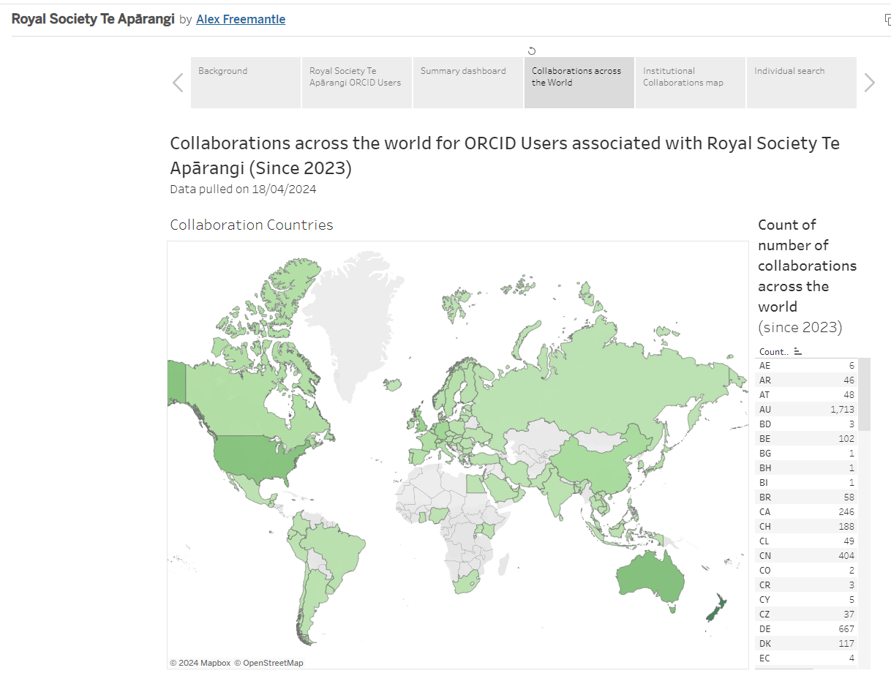
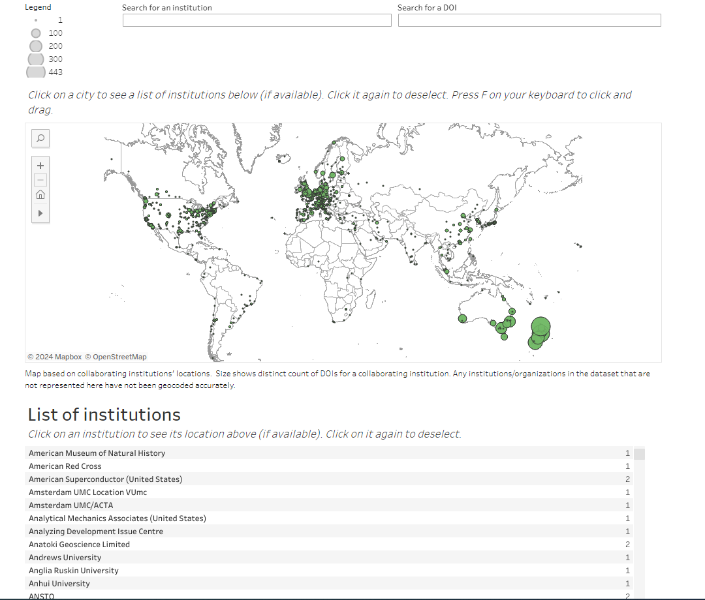
ORCID Statistics and Insights Project
Notes:
The approach was different for RSTA as we wanted anyone who had received funding from us too. And affiliation for us is awards, services rather than employment. Consider how your organisation is relevant

Slide 18


Thank you for attending!
orcid@royalsociety.org.nz

